Slide 1
SECURING AGRICULTURAL SUPPLY CHAIN USING BLOCKCHAIN BY 19R11A1231 VENU MADHAV 19R11A1250 SHREYA REDDY 19R11A1242 ROHAN KUMAR

Slide 2
CONTENTS
Abstract
Introduction
Literature Survey
Existing System
Proposed System
Requirements
Algorithms
Modules
System Architecture
UML Diagrams
Results
Conclusion
Future Work
References

Slide 3
Abstract
In agri-food supply chains (ASCs), consumers pay for agri-food products produced by farmers. During this process, consumers emphasize the importance of agri-food safety while farmers expect to increase their profits. Due to the complexity and dynamics of ASCs, the effective traceability and management for agri-food products face huge challenges. However, most of the existing solutions cannot well meet the requirements of traceability and management in ASCs. To address these challenges, we first design a blockchain-based ASC to provide product traceability, which guarantees decentralized security for the agri-food tracing data in ASCs. Next, a Deep Reinforcement learning based Supply Chain Management (DR-SCM) method is proposed to make effective decisions on the production and storage of agri-food products for profit optimization. The extensive simulation experiments are conducted to demonstrate the effectiveness of the proposed blockchain-based framework and the DR-SCM method under different ASC environments. The results show that reliable product traceability is well guaranteed by using the proposed blockchain-based ASC Q-learning method.

Slide 4
INTRODUCTION
In Agri-Food supply chains there will be two users such as customers who wants to know quality of the product and farmers who wants to maximize their profit by effective management of production details. Blockchain will verify all existing hash codes of all nodes and if block data not alter then all nodes hash code verification will be successful and new transaction will be stored and if verification failed at any node then Blockchain will consider that node as attacked and instruct it to get recovered with genuine blocks. This process is known as PROOF of Work and by using this techniques we can assured customers will get genuine details on product.
Various users may store or view product details in Blockchain such as Seed Providers, Farmers, Processors, Distributors, Retailers and consumers.
In this task traceability face huge challenges, for example all supply and food manufacturing and quality details stored at centralized single server and some malicious users (internal employees) can collect bribes from cheap quality manufacturer to make their product details (fake) as super quality and update centralized server and normal customers will view such fake quality details and trust blindly as there is no one to inform customer about its true quality.

Slide 5
LITERATURE SURVEY
Managing Food Safety With Pricing, Contracts and Coordination in Supply Chains
https://ieeexplore.ieee.org/document/8863899
ABSTRACT: This study aims to design a safe and sustainable food supply chain with food safety mechanisms so that confidence-dependent demand can be positively affected by centralized, decentralized and combined supply chain contracts. To determine the optimal order quantity, buy-back price, rebate/penalty and sales target with the proposed framework, we derive the optimality conditions of corresponding models and use the results to analyze the lard oil supply chain. It is found that supply chain contracts together with the food safety mechanism can drastically improve food safety, consumer confidence and the resulting profits of a food supply chain. What differentiates our work from earlier research efforts is that only few studies have focused primarily on food safety mechanisms that embed a closed-loop supply chain to benefit all stakeholders of a supply chain and we attempt to bridge the gap. Further improvements can be developed based on the models developed in this study.

Slide 6
EXISTING SYSTEM
During this process, consumers emphasize the importance of agri-food safety while farmers expect to increase their profits. Due to the complexity and dynamics of ASCs, the effective traceability and management for agri-food products face huge challenges. However, most of the existing solutions cannot well meet the requirements of traceability and management in ASCs. To address these challenges, we introduced a blockchain-based ASC.
Disadvantages:
Effective traceability and management for agri-food products face huge challenges.

Slide 7
PROPOSED SYSTEM
We first design a blockchain-based ASC to provide product traceability, which guarantees decentralized security for the agri-food tracing data in ASCs. Next, a Deep Reinforcement learning based Supply Chain Management (DR-SCM) method is proposed to make effective decisions on the production and storage of agri-food products for profit optimization. The extensive simulation experiments are conducted to demonstrate the effectiveness of the proposed blockchain-based framework and the DR-SCM method under different ASC environments. The results show that reliable product traceability is well guaranteed by using the proposed blockchain-based ASC Q-learning method.
Advantages:
The results show that reliable product traceability is well guaranteed by using the proposed blockchain-based ASC.

Slide 8
REQUIRMENTS
SOFTWARE REQUIREMENTS
The functional requirements or the overall description documents include the product perspective and features, operating system and operating environment, graphics requirements, design constraints and user documentation.
The appropriation of requirements and implementation constraints gives the general overview of the project in regards to what the areas of strength and deficit are and how to tackle them.
Python idel 3.7 version (or)
Anaconda 3.7 ( or)
Jupiter (or)
Google colab

Slide 9
REQUIRMENTS
HARDWARE REQUIREMENTS
Minimum hardware requirements are very dependent on the particular software being developed by a given Enthought Python / Canopy / VS Code user. Applications that need to store large arrays/objects in memory will require more RAM, whereas applications that need to perform numerous calculations or tasks more quickly will require a faster processor.
Operating system : windows, linux
Processor : minimum intel i3
Ram : minimum 4 gb
Hard disk : minimum 250gb

Slide 10
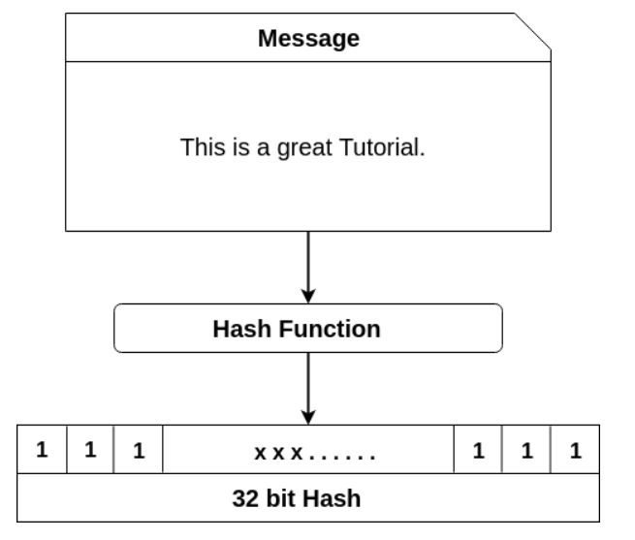
ALGORITHMS
Blockchain Hash Function
A hash function takes an input string (numbers, alphabets, media files) of any length and transforms it into a fixed length. The fixed bit length can vary (like 32-bit or 64-bit or 128-bit or 256-bit) depending on the hash function which is being used. The fixed-length output is called a hash. This hash is also the cryptographic byproduct of a hash algorithm. We can understand it from the following diagram.

Slide 11
MODULES
In this project they have designed above two techniques as simulation so we also implemented this project as simulation and this project consists of following modules
Save ASC Details in Blockchain: using this module we will take product details from users such as farmers, providers, and processors and then store all this details in Blockchain and will Blockchain will store this data as blocks of transaction and for each block it will generate hash code and verified with previous block hash code.
Get ASC Details from Blockchain: using this module all users can read or extract details from Blockchain
Deep Reinforcement Learning Simulation: using this module we will feed current agriculture stock data to DRL algorithm and then this algorithm will trained itself on available stock and then predict STOCK manufacturing or SALE to farmer
Rewards Graph: for each correct prediction DRL will rewards to its decision and for each wrong prediction DRL will get 0 or penalty deduction and the higher the reward the correct is the prediction. In DRL we will take current stock quantity as STATE and producing or selling STOCK will be action.
Blockchain Computation Graph: using this module we will plot Blockchain hash computation time graph
Get All Blockchain Products ID: using this module we can get all product ID’s stored in Blockchain.

Slide 12
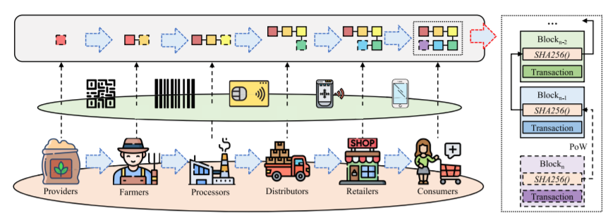
SYSTEM ARCHITECTURE

Slide 13
UML DIAGRAMS

Slide 14
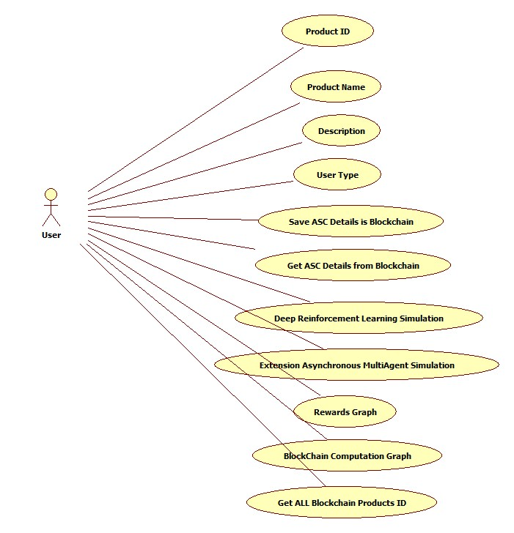
USECASE DIAGRAM

Slide 15
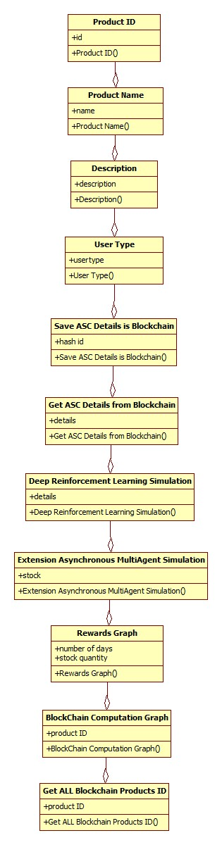
CLASS DIAGRAM

Slide 16
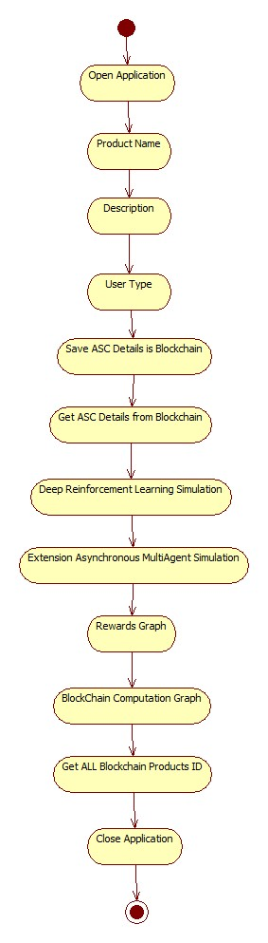
ACTIVITY DIAGRAM

Slide 17
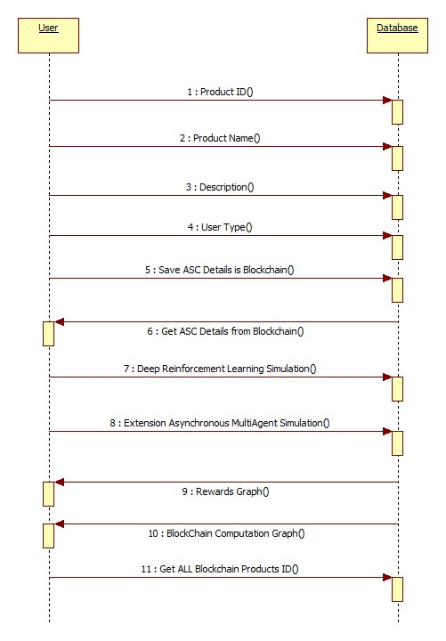
SEQUENCE DIAGRAM

Slide 18
RESULTS

Slide 19
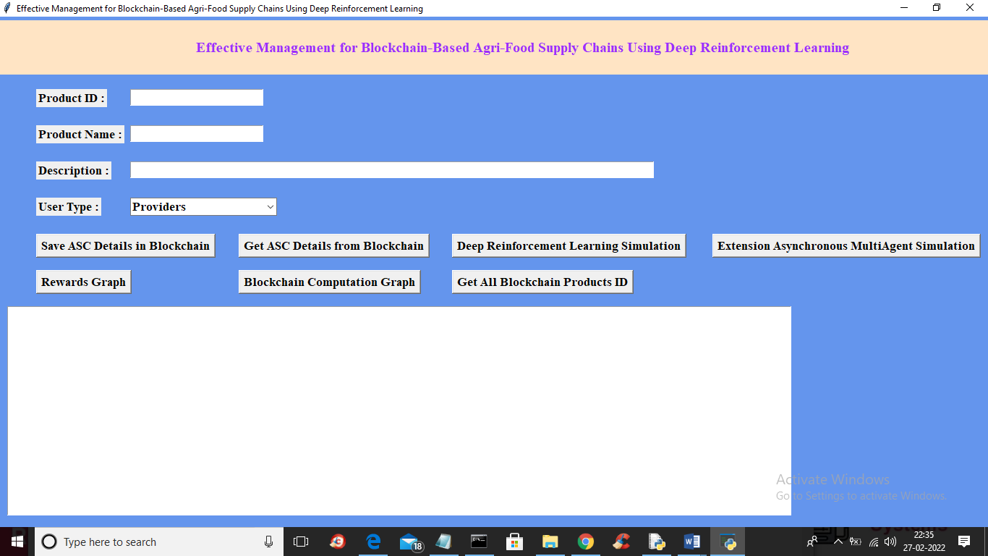

Slide 20


Slide 21
CONCLUSION
In this paper, we first design a blockchain-based to guarantee the agri-food safety with product traceability in ASC systems. Next, we propose a DR-SCM method to make decisions on the production and storage of agri-food products for optimizing product profits in ASCs. The extensive simulation experiments verify the effectiveness of the proposed blockchain-based and the DR-SCM method for ASC optimization. More specifically, the results show that the proposed blockchain-based ASC can well guarantee reliable product traceability. Moreover, the DR-SCM outperforms common heuristic and Q-learning methods in terms of rewards (i.e. product profits) while achieving high learning efficiency in different scenarios of ASC management. Meanwhile, the DR-SCM has higher flexibility than others in arranging production and storage. In the real-world ASC environment, the demands from consumers are changing during different time periods. Based on the simulation experiments conducted by using the DR-SCM, the macro-control for the production and storage of agricultural products can be effectively performed.

Slide 22
FUTURE WORK
To address this problem, in the future, we will continue our research by scaling the system in more complex scenarios of ASC management with the demands constructed by using real-world data. Meanwhile, we will evaluate the robustness and potential improvements by using these algorithms and explore their feasibility in real-world ASC environments.

Slide 23
REFERENCES
[1] D.-Y. Lin, C.-J. Juan, and C.-C. Chang, ‘‘Managing food safety with pricing, contracts and coordination in supply chains,’’ IEEE Access, vol. 7, pp. 150892–150909, 2019.
[2] H. Fan, ‘‘Theoretical basis and system establishment of China food safety intelligent supervision in the perspective of Internet of Things,’’ IEEE Access, vol. 7, pp. 71686–71695, 2019.
[3] M. Toledo-Hernández, T. Tscharntke, A. Tjoa, A. Anshary, B. Cyio, and T. C. Wanger, ‘‘Hand pollination, not pesticides or fertilizers, increases cocoa yields and farmer income,’’ Agricult., Ecosyst. Environ., vol. 304, Dec. 2020, Art. no. 107160.
[4] J. Himmelstein, A. Ares, D. Gallagher, and J. Myers, ‘‘A meta-analysis of intercropping in Africa: Impacts on crop yield, farmer income, and integrated pest management effects,’’ Int. J. Agricult. Sustainability, vol. 15, no. 1, pp. 1–10, Jan. 2017.
[5] Y. Dong, Z. Fu, S. Stankovski, S. Wang, and X. Li, ‘‘Nutritional quality and safety traceability system for China’s leafy vegetable supply chain based on fault tree analysis and QR code,’’ IEEE Access, vol. 8, pp. 161261–161275, 2020.

